Slide 1
Chongqing University of Technology
ATAI
Advanced Technique of Artificial Intelligence
Chongqing University of Technology
https://github.com/xjtuwgt/GNN-MAGNA
Multi-hop Attention Graph Neural Networks
Guangtao Wang1 , Rex Ying2 , Jing Huang1 and Jure Leskovec2
1JD AI Research
2Computer Science, Stanford University
guangtao.wang@jd.com, rexying@stanford.edu, jing.huang@jd.com, jure@cs.stanford.edu
https://github.com/xjtuwgt/GNN-MAGNA
IJCAI_2021
Reported by Xinsheng Wang

Slide 2
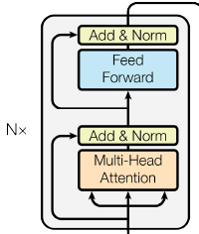
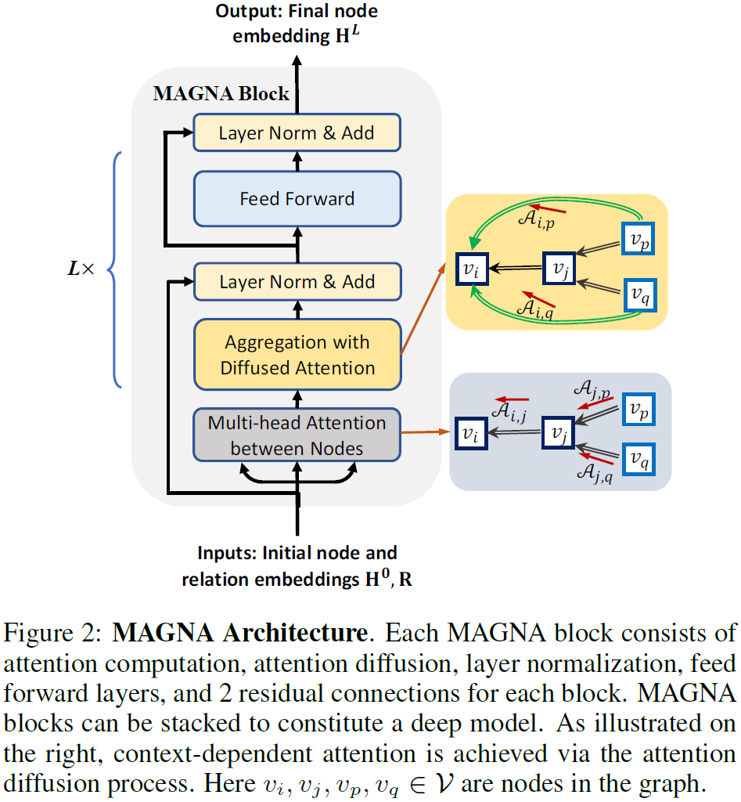
Method
Edge Attention Computation
Transformer-encoder
Notes:
H初始化是节点的特征，关系r是可训练的embedding，va是可训练参数
注意力分数矩阵S

Slide 3
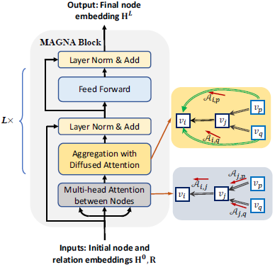
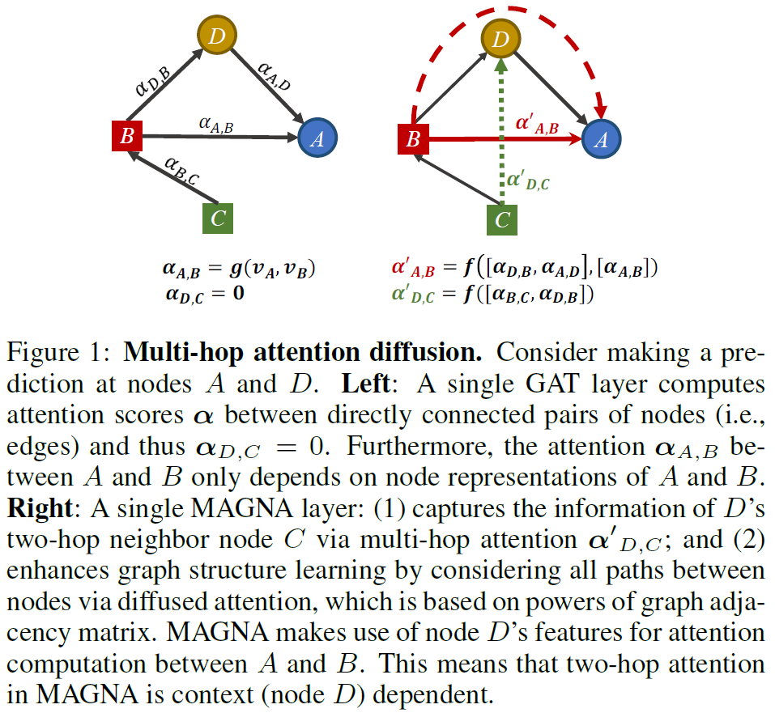
Method
Attention Diffusion for Multi-hop Neighbors
Notes:
i表示获取i跳路径的邻居，后面有消融实验

Slide 4
Method
Multi-head Graph Attention Diffusion Layer
Deep Aggregation
Notes:
7、残差连接

Slide 5
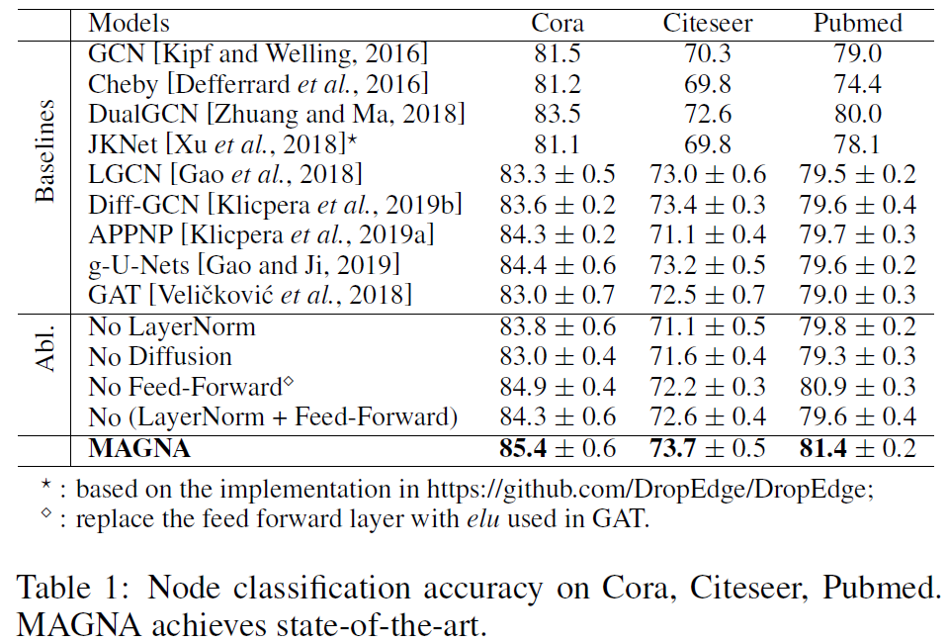
Experiments

Slide 6
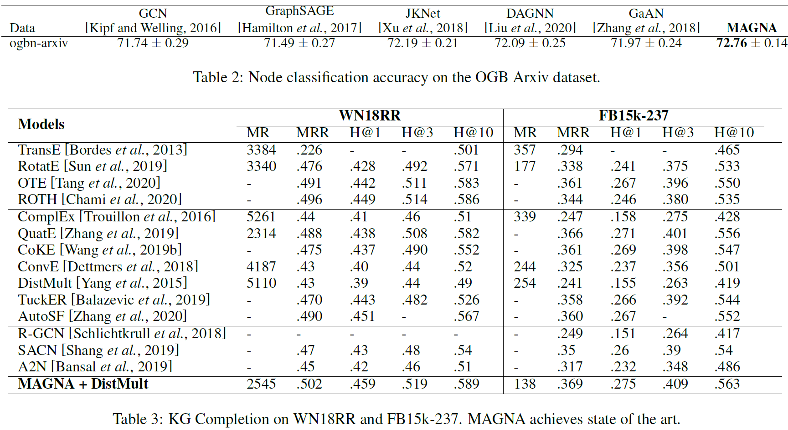
Experiments

Slide 7
Experiments
Notes:
Alpha的对于拉普拉斯矩阵的算子的影响，即特征值

Slide 8
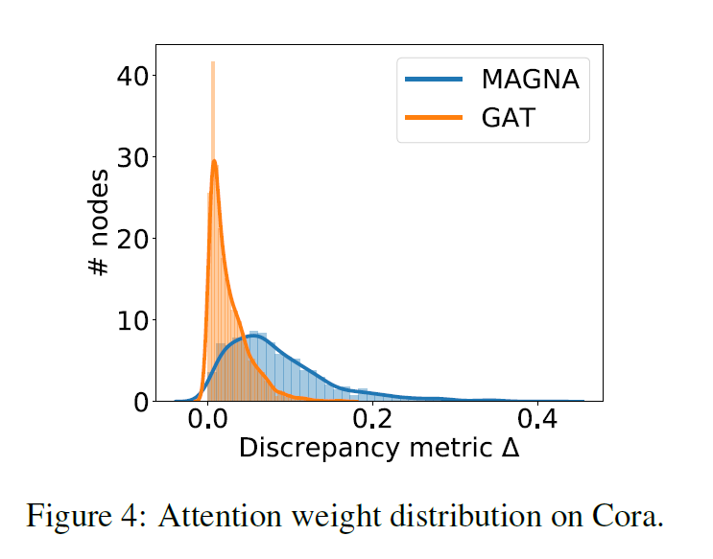
Experiments

Slide 9
Thank you!

